Slide 1
Instructions for generating PNGs
For images with drop shadows:
Select the slide containing the picture to export
Select File → Export…
Choose “PNG” as the file type and save the PNG file.
Open the PNG file in Preview and peform cropping and alpha channel adding
For images without drop shadows:
Select all the components of the image
Right-click and select “Save as picture…” from the context menu

Slide 5
Spans of individual tokens
Spans of containing sentences
Token features
Token features

Slide 8
Spans of individual tokens
(SpanArray)
BERT embedding at each token position (TensorArray)

Slide 11
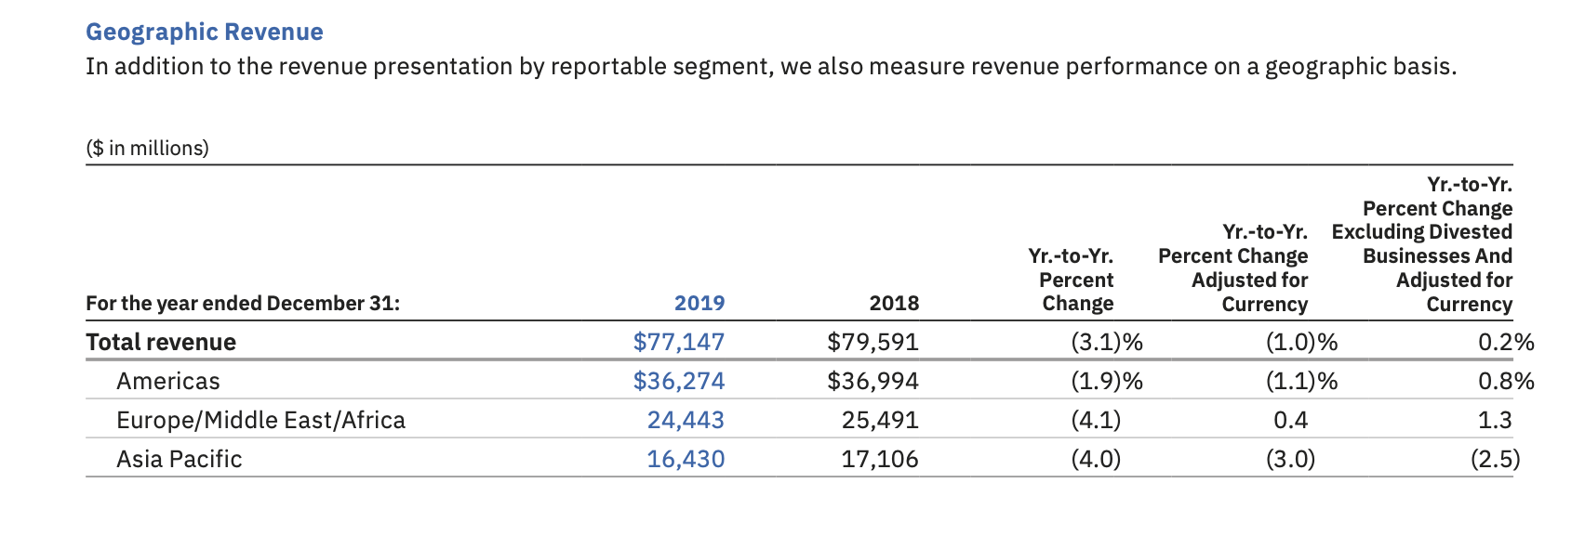
Original table in PDF file
Reconstructed Pandas DataFrame

